Slide 1
CSCI 6660-01 Intro to Artificial Intelligence TERM -PROJECT
Professor: Dr. Shivanjali Khare TEAM MEMBERS
Bhargava Sriraj Meesala 00767182
Satvika Durnala 00763282
Anusha Chittipolu 00762040

Slide 2




PROJECT TOPIC FIRE DETECTION MODEL

Slide 3
CONTENTS
-> IMPORTANCE OF A FIRE DETECTION MODEL
-> PROJECT OBJECTIVES
-> APPROACH
-> GUI OF THE CODE
-> XML FILE CONTENTS
->DELIVERABLES
-> EVALUATION METHODOLOGY
->CONCLUSION

Slide 4
IMPORTANCE OF A FIRE DETECTION SYSTEM
Early fire detection is crucial and plays a very important role in protecting and saving lives and properties. Having a fire detection system can significantly reduce damages and maximize fire control efforts.
It is also one of the most fundamental steps you can take for fire safety measures. Even if you are sleeping or busy working, early fire detection will warn you and help you respond quickly so you'll be out of danger. Here are some good reasons why you need fire detection systems at home or your business.
-> SAVE LIVES
-> EARLY ACTION
-> REDUCE LOSS OF PROPERTY

Slide 5
PROJECT OBJECTIVES
Objective 1 - The Model should be able to detect and identify fire, within the camera’s vicinity using the cascade classifier.
Objective 2 - The system should sound the alarm once a fire is detected.
Objective 3- The system should send an email about the hazard to the fire department.

Slide 6
APPROACH
The project is done using Python language. We are using the OpenCV module to enable Computer Vision and we are providing an XML dataset loaded with different image values of FIRE for our model to have its basis. We are using HSV color mode and Cascade classifier
We give permission for the program to access the camera and then continuously monitor for a FIRE, and when the system detects fire, it would sound the alarm using the playsound module and then will send an email to the fire department using SMTP protocol.
The model learns from the XML file we are providing and basis the results on it.
Modules used are cv2 (OpenCV), playsound, threading, smtplib, opencv-contrib-python.
To achieve objective 1, we will use the XML file and the opencv module.
To achive Objectives 2 and 3, we will use the playsound, smtplib modules.

Slide 7
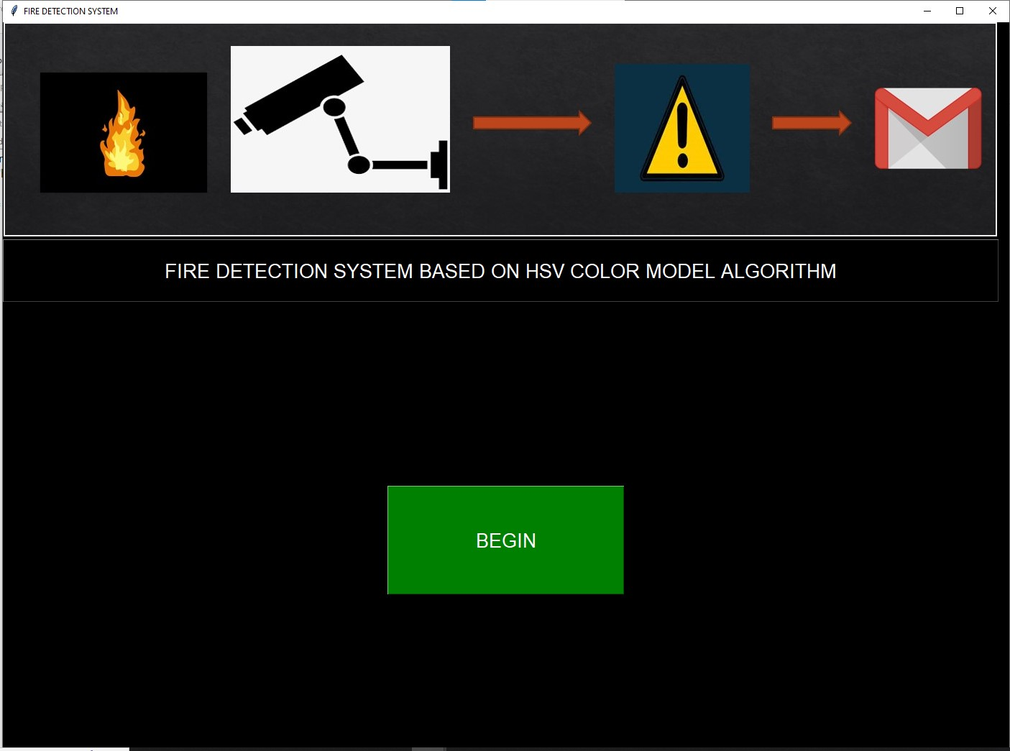
GUI of the Project using TKINTER Module

Slide 8
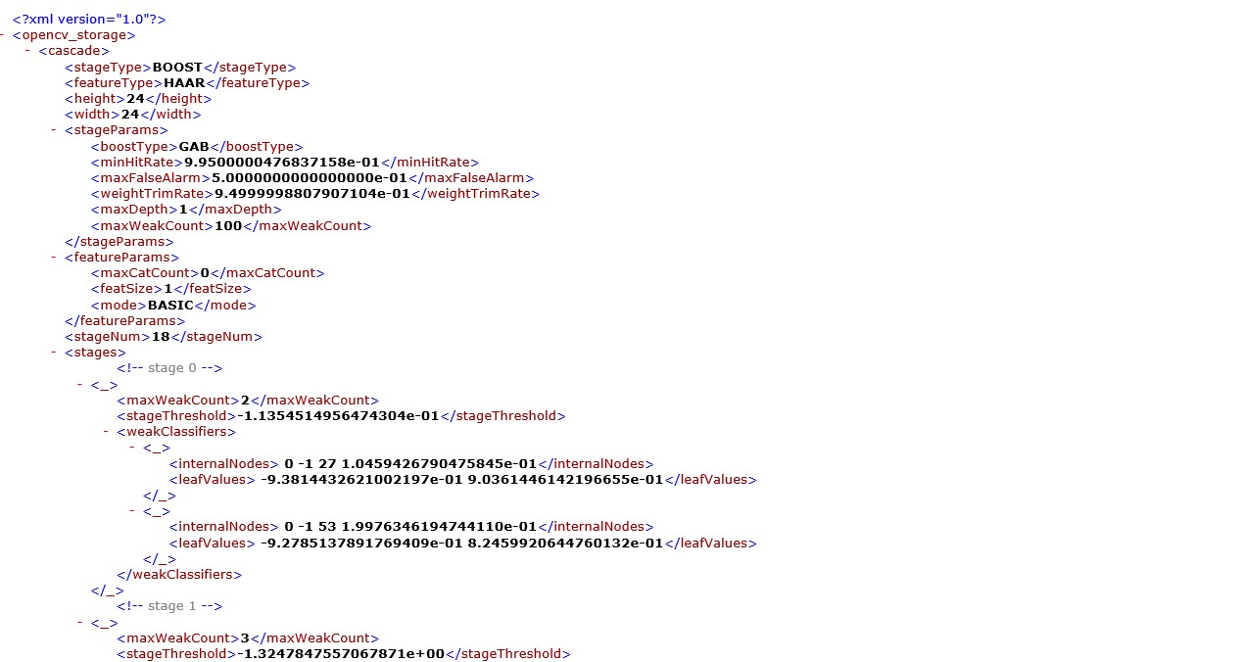
This is how the XML FILE looks like

Slide 9
DELIVERABLES
First, in the folder, we have the .XML file where the image vector values are stored, which form the basis for our model, to detect fire.
Next we have an .mp3 audio file which we need the system to play once a fire is detected.
Next we have the main.py Python file where all the code is written for Fire Detection.

Slide 10
EVALUATION METHODOLOGY
Before you run the code, you need to make some changes in the code.
First, you need to install the modules using the pip command. The modules are opencv-contrib-python , opencv-python, threading, playsound, smtplib.
Secondly, place your email in the code so that when a fire is detected, the warning mail would be sent to that email.
Finally, run the code and the when the web camera turns on, light a match or a lighter in front of the camera and fire will be detected.

Slide 11
CONCLUSION
Early fire detection is tantamount to saving lives and property. Thus, investing in a good fire alarm system will help prevent a tragic incident from happening.
Always remember that it is better to be prepared anytime, anywhere, and help save lives and protect properties.

Slide 12


